Slide 1
  Chapter 16
计算机图形学和娱乐：电影，游戏和虚拟社区
  Computer Graphics and Entertainment: Movies, Games, and Virtual Communities

Slide 2
Learning Objectives (1 of 2)
Describe the changes in movie animation techniques caused by computer generated imagery (CGI)
List the steps in the graphics pipeline
Explain how to create a computer model of a 3D object
Understand how a transformation matrix can model the movement of an object
Name three challenges involved in rendering a visual object
Notes:
描述由计算机生成的图像（CGI）引起的电影动画技术的变化
列出图形管道中的步骤
说明如何创建3D对象的计算机模型
了解转换矩阵如何模拟对象的运动
列出渲染视觉对象涉及的三个挑战

Slide 3
Learning Objectives (2 of 2)
Explain the purpose and function of a graphics processing unit (GPU)
List and explain two techniques for achieving the real-time graphics required for video-game animation as opposed to movie animation
Describe how large virtual communities work, and the particular challenges they face
Notes:
说明图形处理单元（GPU）的目的和功能
列出并说明实现视频游戏动画（而不是电影动画）所需的实时图形的两种技术
描述大型虚拟社区的工作方式以及面临的特殊挑战

Slide 4
Introduction (1 of 2)
Early computers were too expensive and rare for use as entertainment (1950s–1960s)
When minicomputers arrived, college students began writing games for them (1970s)
Atari created Pong, first commercial game (1975)
Use in movies grew in early 1990s (Terminator 2, Jurassic Park)
Now entertainment is a huge, multi-billion dollar segment of the industry

Slide 5
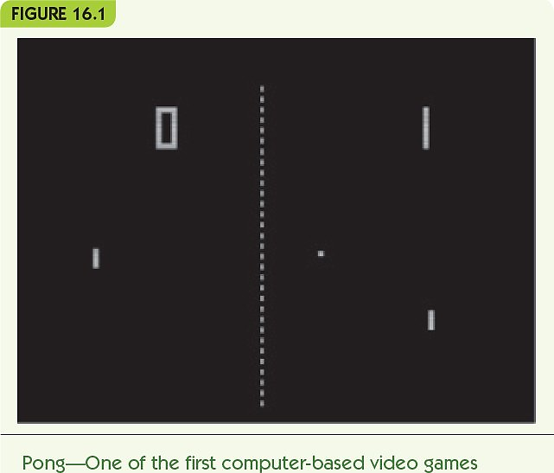
Introduction (2 of 2)
Invitation to Computer Science, 8th Edition © 2019 Cengage. All rights reserved.

Slide 6
Computer-Generated Imagery (CGI) (1 of 18)
Movie animation in the past
  Hand-drawn (e.g., Walt Disney)
  Stop-motion animation
    Clay figures posed, photographed, then moved slightly repeatedly in a series of frames
Computer animation developed in the 1980s and 1990s
  Terminator 2: Judgment Day
  Jurassic Park
Computer-generated imagery (CGI) produces photorealistic animation
Notes:
过去的电影动画
手绘（例如Walt Disney）
定格动画
黏土人像摆姿势，拍照，然后在一系列帧中反复轻微移动
1980年代和1990年代开发的计算机动画
终结者2：审判日
侏罗纪公园
计算机生成的图像（CGI）产生逼真的动画

Slide 7
Computer-Generated Imagery (CGI) (2 of 18)
The graphics pipeline: sequence of tasks to generate CGI images/movies
Object modeling: create model of 3D object
Object motion: apply transformations to move objects
Rendering and display: incorporate lighting, shadows, and textures
Notes:
图形管道：生成CGI图像/电影的任务序列
对象建模：创建3D对象模型
对象运动：应用变换来移动对象
渲染和显示：合并照明，阴影和纹理

Slide 8
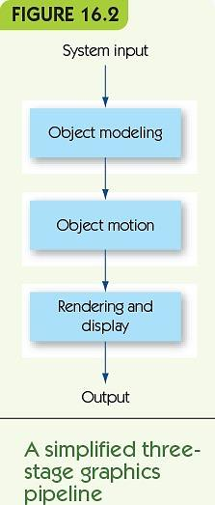
Computer-Generated Imagery (CGI) (3 of 18)
Invitation to Computer Science, 8th Edition © 2019 Cengage. All rights reserved.

Slide 9
Computer-Generated Imagery (CGI) (4 of 18)
线框建模
Wireframe modeling is a common approach to object modeling
Take an image and create a tessellation
  Divide object surface into planar polygons
    Polygons share edges and vertices
    Polygons completely cover object surface
    Polygon mesh: result looks like a wire model
  Convert to three dimensions
  Generate a vertex list, a table of all vertices and their 3D position
镶嵌
Notes:
线框建模是对象建模的常用方法
拍摄图像并创建镶嵌
将物体表面划分为平面多边形
多边形共享边和顶点
多边形完全覆盖对象表面
多边形网格：结果看起来像导线模型
转换为三维
生成顶点列表，所有顶点的表及其3D位置

Slide 10
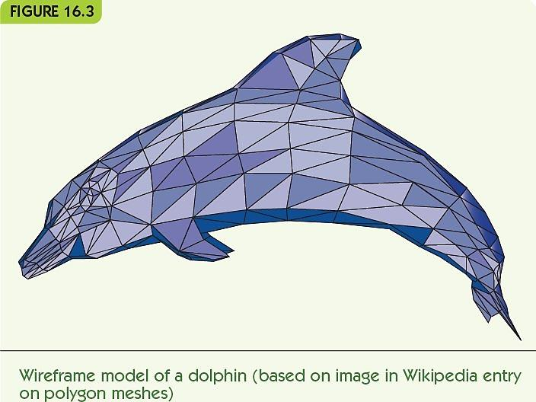
Computer-Generated Imagery (CGI) (5 of 18)
Invitation to Computer Science, 8th Edition © 2019 Cengage. All rights reserved.

Slide 11
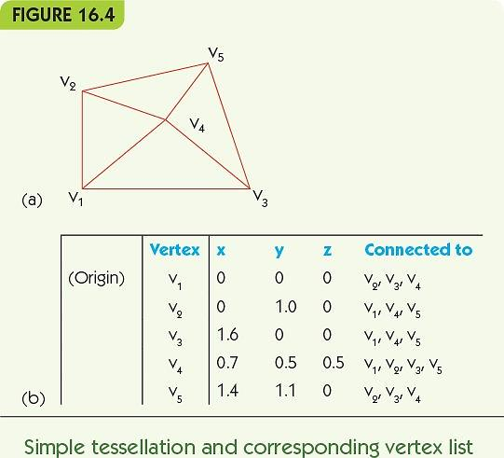
Computer-Generated Imagery (CGI) (6 of 18)
Invitation to Computer Science, 8th Edition © 2019 Cengage. All rights reserved.

Slide 12
Computer-Generated Imagery (CGI) (7 of 18)
Object motion: rigid or deforming
Rigid motion: movement that does not change object’s shape
  Translation: lateral movement, every point changes by the same amount in all three dimensions
  Rotation: circular movement around a fixed point/axis
  Reflection: mirror image of object
Notes:
物体运动：刚性或变形
刚性运动：不改变物体形状的运动
平移：横向运动，每个点在三个维度上的变化相同
旋转：绕固定点/轴的圆周运动
反射：物体的镜像

Slide 13
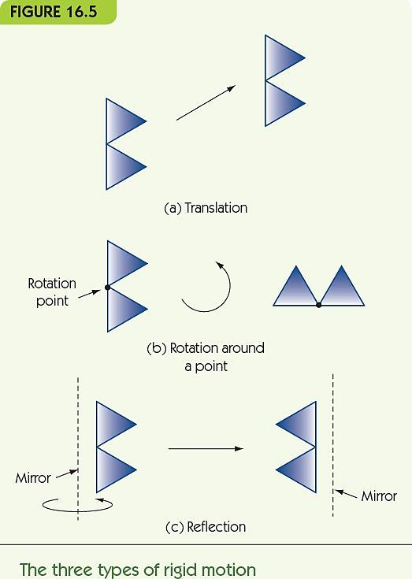
Computer-Generated Imagery (CGI) (8 of 18)
Invitation to Computer Science, 8th Edition © 2019 Cengage. All rights reserved.

Slide 14
Computer-Generated Imagery (CGI) (9 of 18)
Implement movements using matrix multiplication
Transformation matrix
  Defines a particular motion
  Multiply vector for vertex position (x, y, z) by transformation matrix
  Result is a new location for that point, as a vector
Example: move point at (x, y, z) to (x+a, y+b, z+c)
Create motion by repeating for small a, b, c
Keyframing: user gives start and end positions, computer generates the intermediate movements
Notes:
使用矩阵乘法实现运动
转换矩阵
定义一个特定的动作
顶点矩阵（x，y，z）的矢量乘以变换矩阵
结果是作为矢量的该点的新位置
示例：将（x，y，z）处的点移动到（x + a，y + b，z + c）
通过重复小a，b，c来创建运动
关键帧：用户指定开始和结束位置，计算机生成中间动作

Slide 15
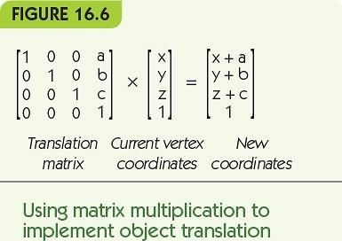
Computer-Generated Imagery (CGI) (10 of 18)
Invitation to Computer Science, 8th Edition © 2019 Cengage. All rights reserved.

Slide 16
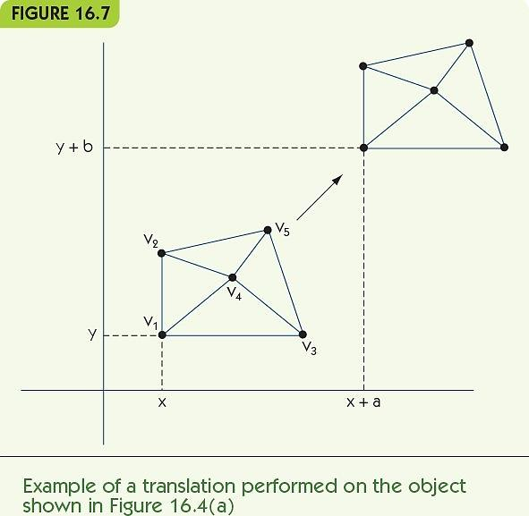
Computer-Generated Imagery (CGI) (11 of 18)
Invitation to Computer Science, 8th Edition © 2019 Cengage. All rights reserved.

Slide 17
Computer-Generated Imagery (CGI) (12 of 18)
Control point (animation variable): a point or axis used to control motion
Multiple control points allow movement of parts of an object
Example: two rotation axes
  One rotates right circle around center point
  One rotates both circles around external point
Notes:
控制点（动画变量）：用于控制运动的点或轴
多个控制点允许移动物体的一部分
示例：两个旋转轴
一个绕中心点向右旋转
一个围绕外部点旋转两个圆圈

Slide 18
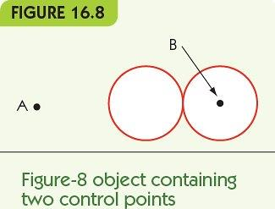
Computer-Generated Imagery (CGI) (13 of 18)
Invitation to Computer Science, 8th Edition © 2019 Cengage. All rights reserved.

Slide 19
Computer-Generated Imagery (CGI) (14 of 18)
Rendering converts a model to a full 3D image
  Lighting
    Fix the location and intensity of all light sources
    Determine the effects on objects
  Color shading
    Assign colors to vertices; blend across polygons
  Shadows
    Account for shadows from other objects
  Texture mapping
    Apply variable surfaces to polygons
  Blur to show motion
Notes:
渲染将模型转换为完整的3D图像
灯光
固定所有光源的位置和强度
确定对对象的影响
颜色底纹
为顶点分配颜色； 跨多边形融合
暗影
考虑其他物体的阴影
纹理贴图
将可变表面应用于多边形
模糊以显示运动

Slide 20
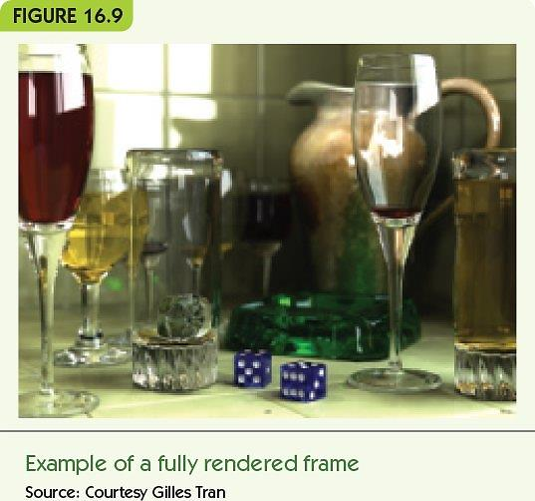
Computer-Generated Imagery (CGI) (15 of 18)
Invitation to Computer Science, 8th Edition © 2019 Cengage. All rights reserved.

Slide 21
Computer-Generated Imagery (CGI) (16 of 18)
Ray tracing is the most common rendering algorithm
  Repeats for each polygon in the object
    For each light source, determine the amount and direction of light from that source
    Combine light sources and determine intensity, color shading, brightness
Last step: convert 3D objects to a 2D image
  Locate viewer; use geometry to determine the view
Notes:
光线追踪是最常见的渲染算法
对对象中的每个多边形重复
对于每个光源，确定来自该光源的光量和方向
组合光源并确定强度，颜色阴影，亮度
最后一步：将3D对象转换为2D图像
找到查看器； 使用几何来确定视图

Slide 22
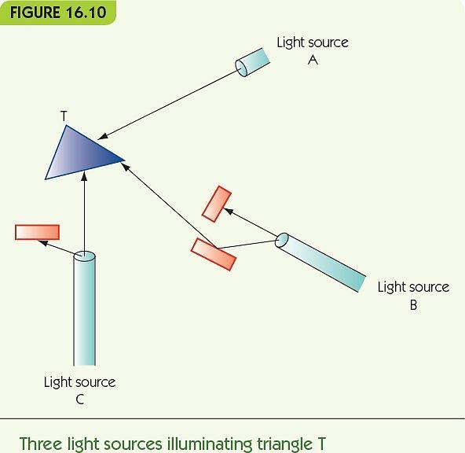
Computer-Generated Imagery (CGI) (17 of 18)
Invitation to Computer Science, 8th Edition © 2019 Cengage. All rights reserved.

Slide 23
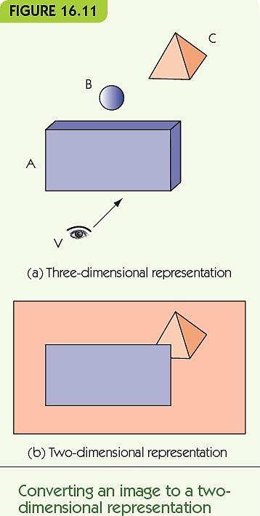
Computer-Generated Imagery (CGI) (18 of 18)
Invitation to Computer Science, 8th Edition © 2019 Cengage. All rights reserved.

Slide 24


Slide 25
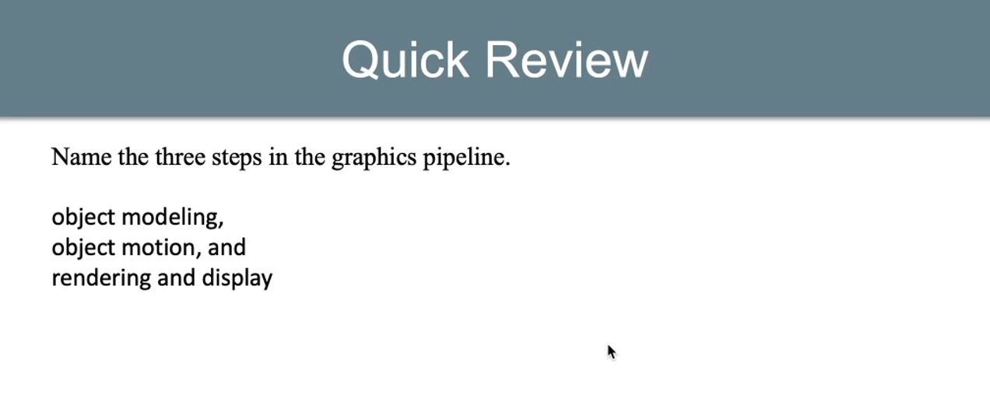

Slide 26
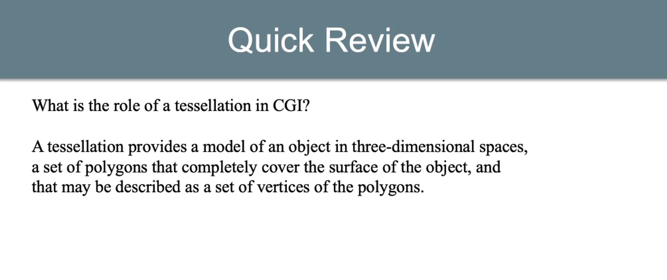

Slide 27


Slide 28
Video Gaming (1 of 4)
Video-game images are similar to CGI
CGI assumes a static environment
  Unlimited time to produce the images
  Created once and shown many times
Video games are a dynamic environment
  User choices change what must be displayed
  Must render images in real-time: real-time graphics
“If necessary, sacrifice image quality
for speed of display”
Notes:
电子游戏图像类似于CGI
CGI假定为静态环境
无限时间生成图像
创建一次并显示多次
电子游戏是一个动态的环境
用户选择更改了必须显示的内容
必须实时渲染图像：实时图形
“如有必要，牺牲图像质量
显示速度”

Slide 29
Video Gaming (2 of 4)
Frame rate is speed of image generation
Computers improve frame rate with a dedicated GPU
Graphics processing unit (GPU)
  A separate processor optimized for CGI
  Dedicated video memory on a video card (graphics card)
Most contemporary computers have GPUs
  Some have multiple GPUs
Notes:
帧速率是图像生成的速度
计算机使用专用GPU提高帧速率
图形处理单元（GPU）
针对CGI优化的独立处理器
显卡（图形卡）上的专用视频内存
大多数当代计算机都具有GPU
有些具有多个GPU

Slide 30
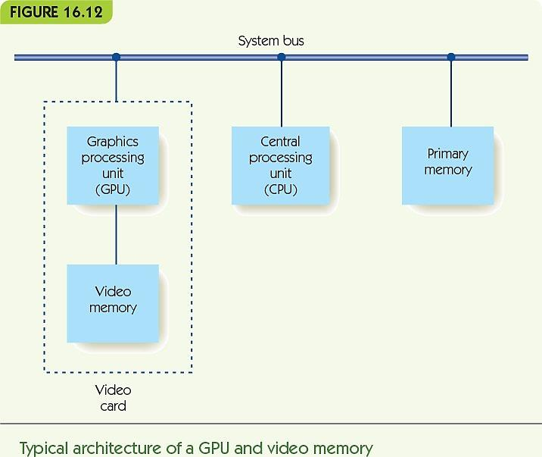
Video Gaming (3 of 4)
Invitation to Computer Science, 8th Edition © 2019 Cengage. All rights reserved.

Slide 31
Video Gaming (4 of 4)
Other methods for achieving real-time graphics
  Avoid time-consuming algorithms (e.g., ray tracing)
  Use fixed colors, with no shadows or shading
  Culling: first determine what is visible, and only render visible elements
  Cut-ins: pre-computed fully rendered objects
    Stored in a video library
    Dropped into the frame as needed
Notes:
其他实现实时图形的方法
避免使用费时的算法（例如光线跟踪）
使用固定的颜色，没有阴影或阴影
剔除：首先确定可见的内容，然后仅渲染可见的元素
切入：预先计算的完全渲染对象
存储在视频库中
根据需要放入框架

Slide 32
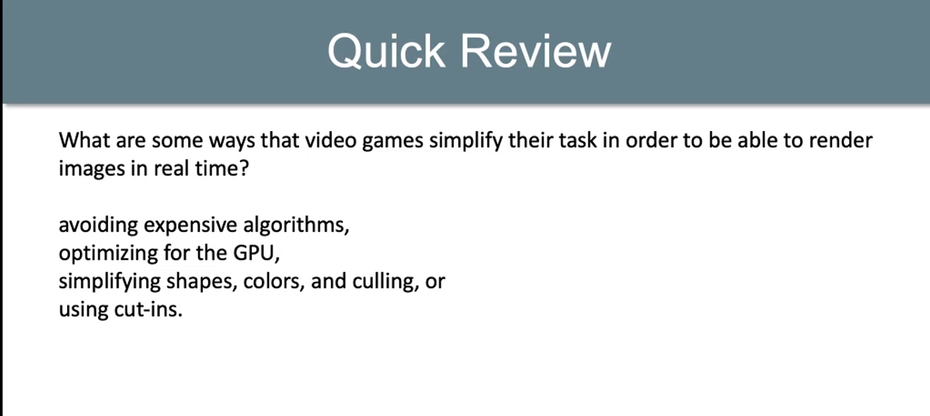

Slide 33
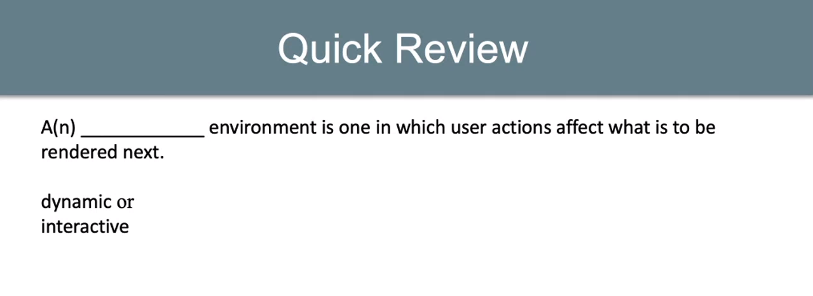

Slide 34


Slide 35
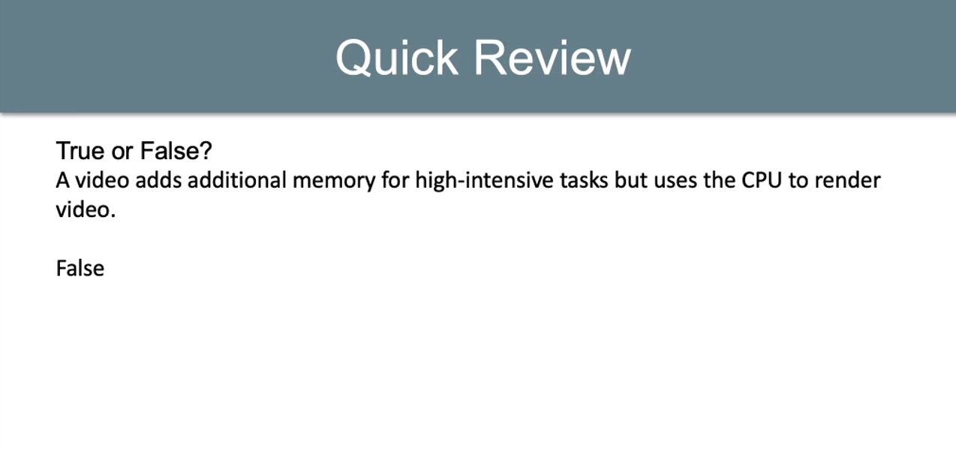

Slide 36
Multiplayer Games and Virtual Communities (1 of 4)
Massively multiplayer online games (MMOG)
  Thousands of players
  Simulated virtual world
  Example: World of Warcraft
Game provided by online game servers
Game world is always available and running
Users log into the game with client software

Slide 37
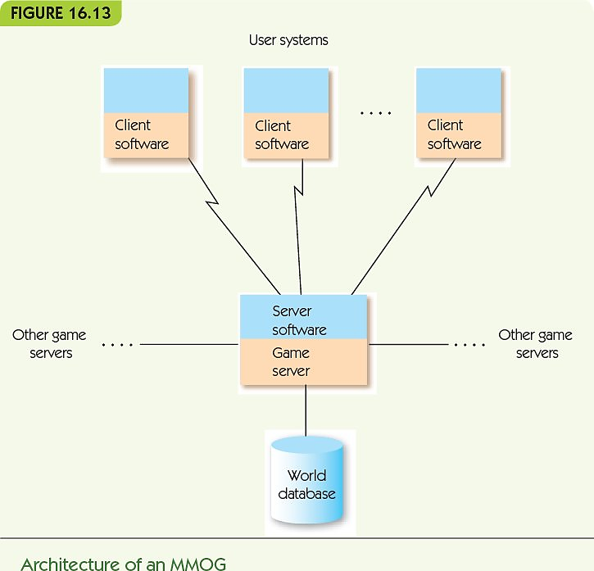
Multiplayer Games and Virtual Communities (2 of 4)
Invitation to Computer Science, 8th Edition © 2019 Cengage. All rights reserved.

Slide 38
Multiplayer Games and Virtual Communities (3 of 4)
MMOG game designers must perform:
  Game play management
    Control game actions and render game images
  Registration management
    Control user accounts, new and returning users
  Client/server protocols for multiple servers and thousands of clients
  Security to ensure authorized access only
  Database storage and retrieval
    Store huge amounts of data, retrieve quickly
Notes:
MMOG游戏设计师必须执行：
游戏管理
控制游戏动作并渲染游戏图像
注册管理
控制用户帐户，新用户和回头用户
多个服务器和数千个客户端的客户端/服务器协议
安全性确保仅授权访问
数据库存储和检索
存储大量数据，快速检索

Slide 39
Multiplayer Games and Virtual Communities (4 of 4)
Virtual communities:
  Noncompetitive MMOG, or metaverse
  Goal is not to score points or win, but to explore and interact, create, and engage in virtual commerce
  Example: Second Life, by Linden Labs
    Several thousand servers
    100 trillion bytes of data
    1 million active “residents”
    ~50,000 online at any one time
Notes:
虚拟社区：
非竞争性MMOG或metaverse
目标不是获得分数或胜利，而是探索和互动，创建和从事虚拟商务
示例：Linden Labs撰写的《第二人生》
几千台服务器
100万亿字节数据
一百万活跃的“居民”
一次约有50,000个在线

Slide 40
Summary (1 of 2)
Use of computers and computer animation in the entertainment industry has grown as the power of computers has grown
CGI allows for photorealistic animation
The graphics pipeline includes object modeling, object motion, and rendering and display
Objects are commonly modeled as tessellations of polygons in three dimensions
Motion is created through matrix multiplication of transformation matrices with vertices of an object
Notes:
随着计算机功能的增强，娱乐行业对计算机和计算机动画的使用也在增长
CGI可实现逼真的动画
图形管道包括对象建模，对象运动以及渲染和显示
通常将对象建模为三维的多边形镶嵌
通过将变换矩阵与对象的顶点进行矩阵乘法来创建运动

Slide 41
Summary (2 of 2)
Rendering must apply color, shading, and texture to images
Ray tracing is a common technique for rendering
Video games must render images in real time
GPUs perform video operations to speed up render time
MMOGs are online games, large-scale computing
Virtual communities like Second Life are noncompetitive MMOGs
Notes:
渲染必须为图像应用颜色，阴影和纹理
光线追踪是渲染的常用技术
电子游戏必须实时渲染图像
GPU执行视频操作以加快渲染时间
MMOG是在线游戏，大规模计算
虚拟人生（例如Second Life）是非竞争性MMOG

